Slide 1
Stay onTime
By Team CubeX
Presented by :Asif Sheikh

Slide 2

Introduction
Stay on Time is an android application built for booking appointments between faculties and student and also providing interface of video chat and maps of BITS-pilani.
SQA Team : N-Li8

Slide 3
Team Members
Asif Sheikh(Captain)
Vishaka Gupta (Vice Captain )
Farha Naaz
Kunal Mehta
Pallavi Panchal
Ayushi Agarwal

Slide 4
Uptill Now…
Prototype of design was discussed and also wireframes were presented by previous developer team
Product Backlog was discussed .
Alpha Release of product by Nayan’s Dfalcons.

Slide 5
Features Implemented
Booking Appointments with Faculty
Video Chat using Webrtc
Message chatting between faculty and students
Static Maps using google Maps API

Slide 6

Splash Screen

Slide 7
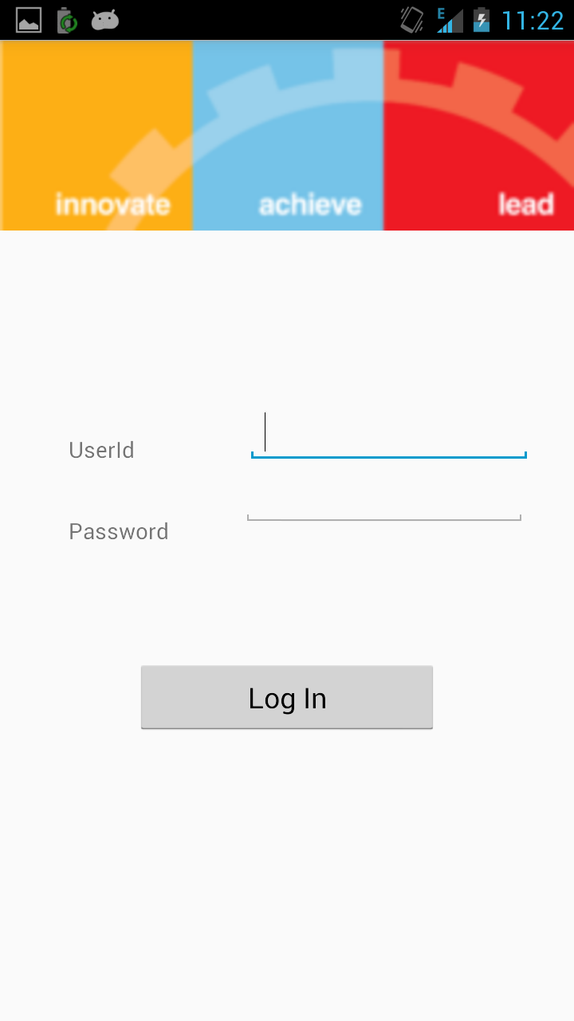
Login
Login using student id .

Slide 8
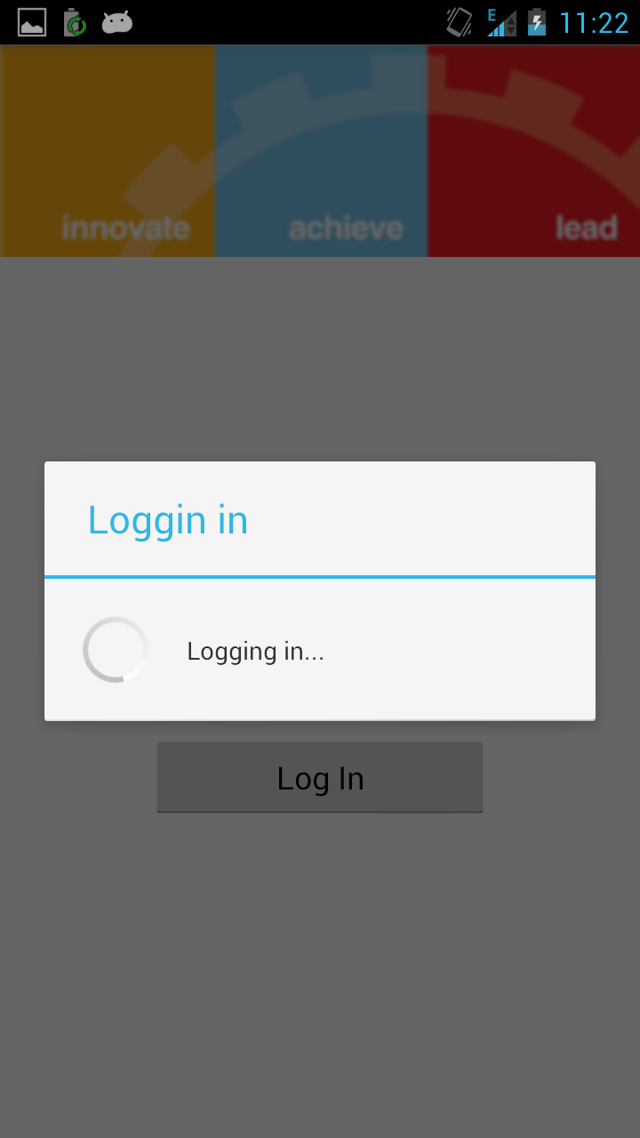
Logging in
After providing username and password ,details are authenticated on web server

Slide 9
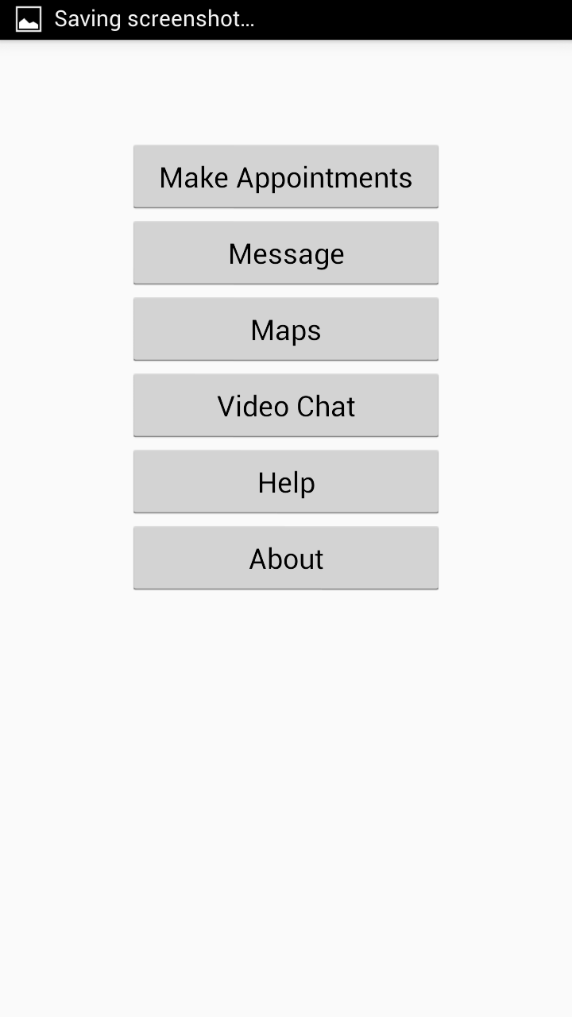
Home Screen
Consists of Make Appointment, Messages, Maps, Video Chat, Help and About Features

Slide 10
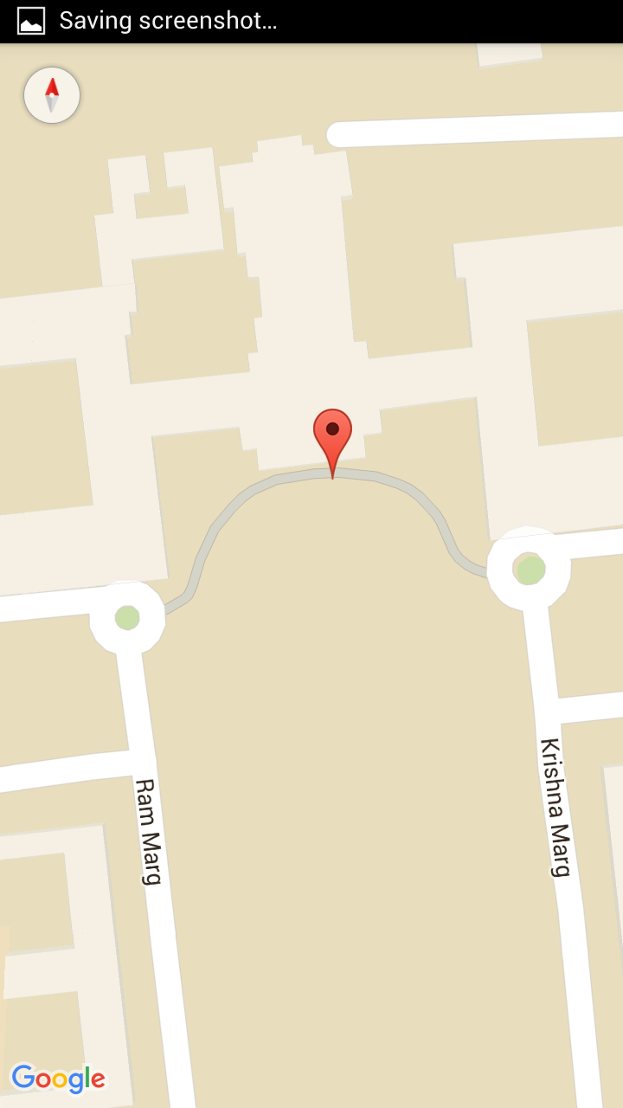
Static Maps
Maps are viewed with a static marker on Bits Pilani

Slide 11
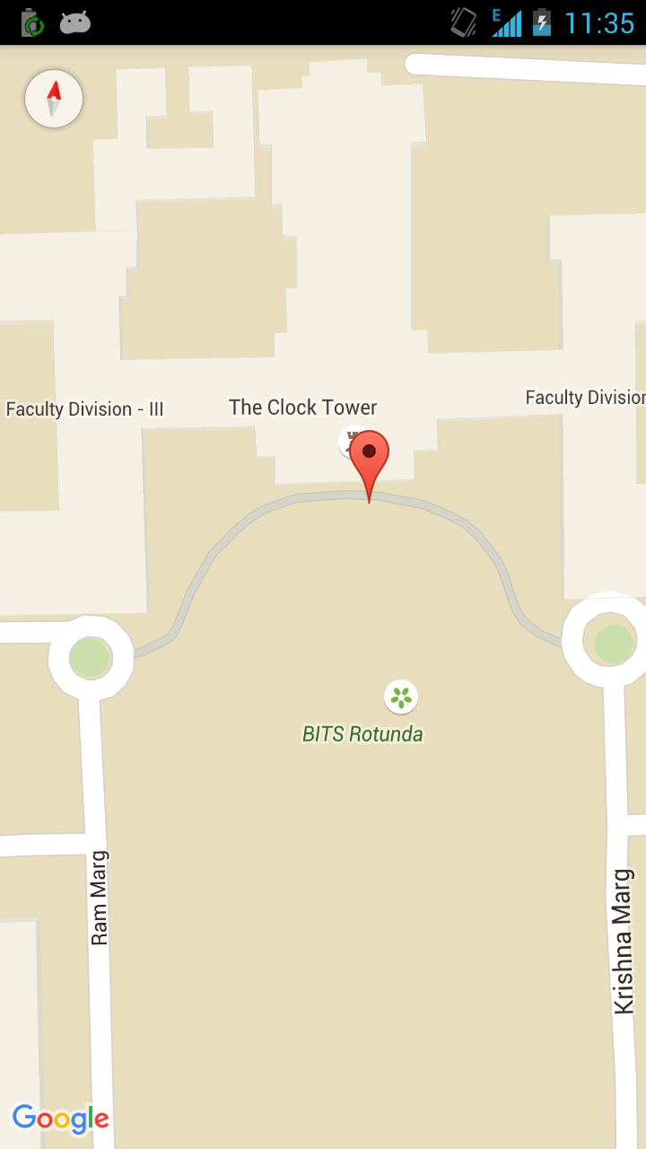
Static Maps
Buildings are marked as we start zooming in

Slide 12
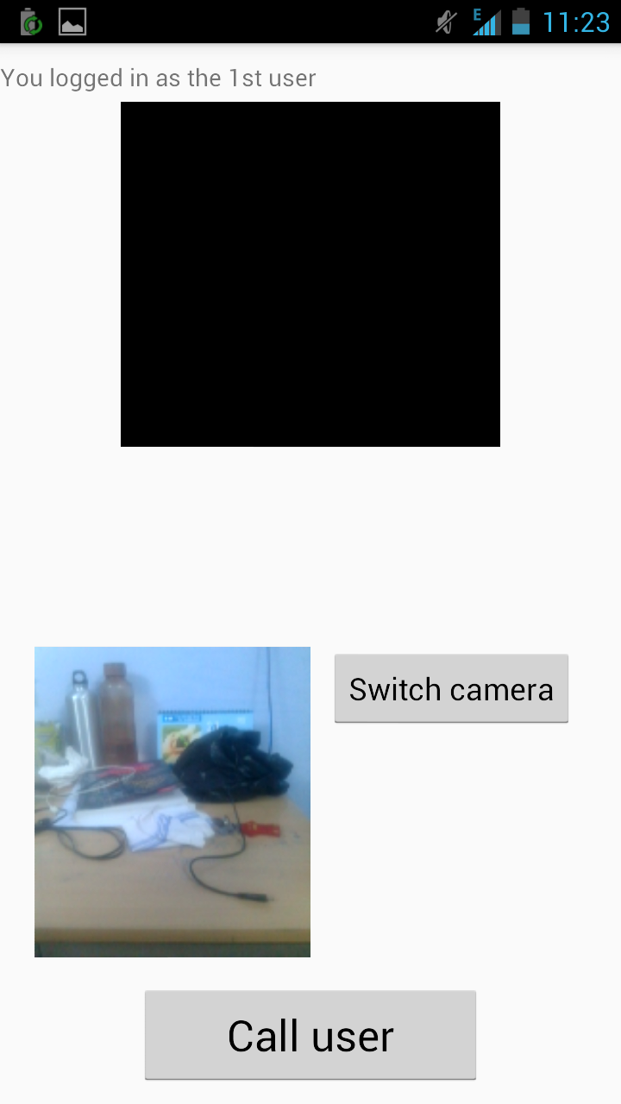
Video Chat
Professor or student can video call each other when ever required

Slide 13
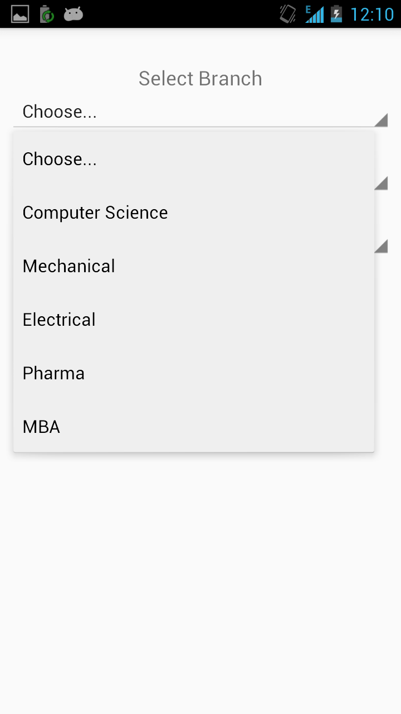
Booking an Appointment
Student selects department of faculty first

Slide 14
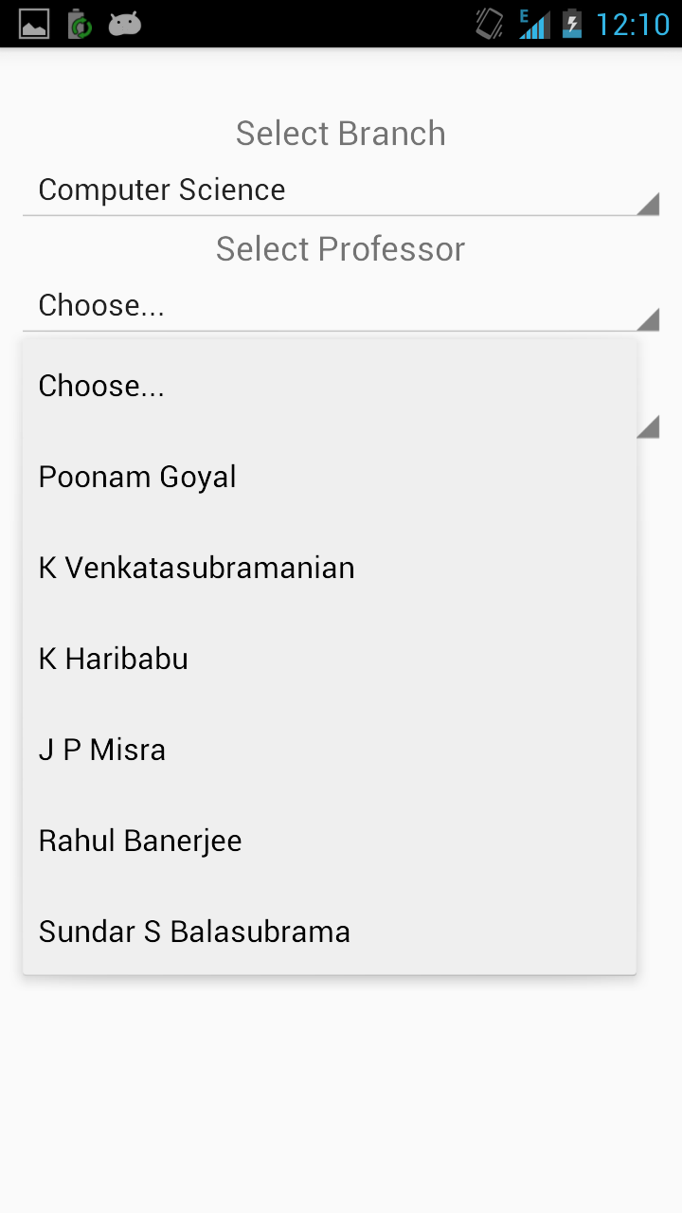
Booking an Appointment
Student selects faculty name from list of faculties .

Slide 15
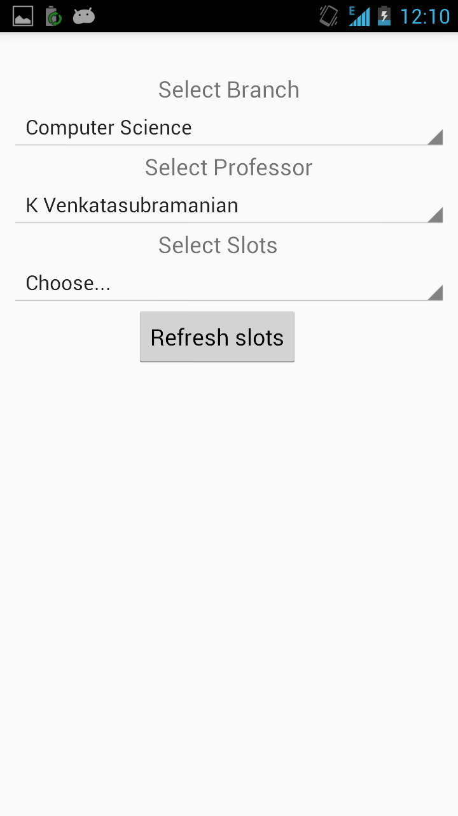
Booking an Appointment
Student selects time slots of concerned faculty

Slide 16
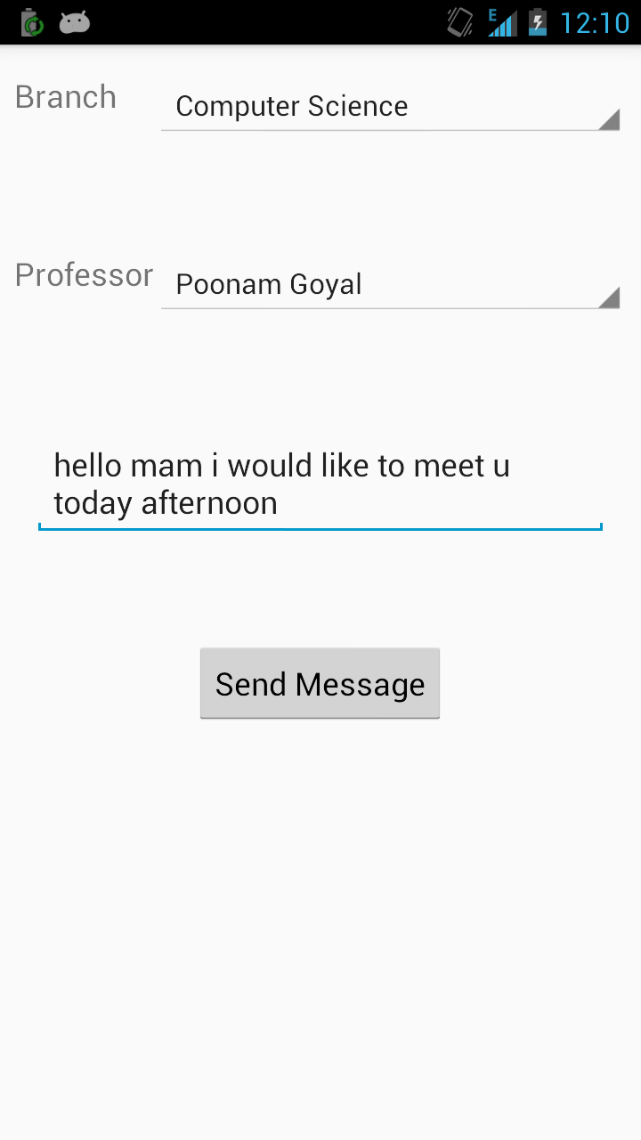
Booking an Appointment
Student can book a time slot provided by faculty

Slide 17
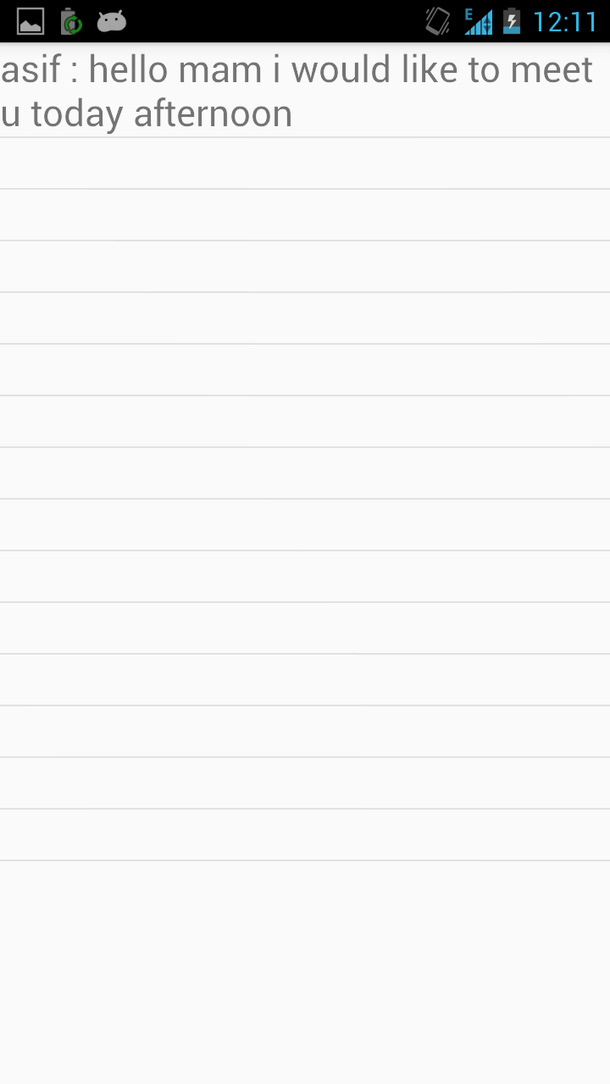
Messages
Faculty or students can view messages sent by each other

Slide 18
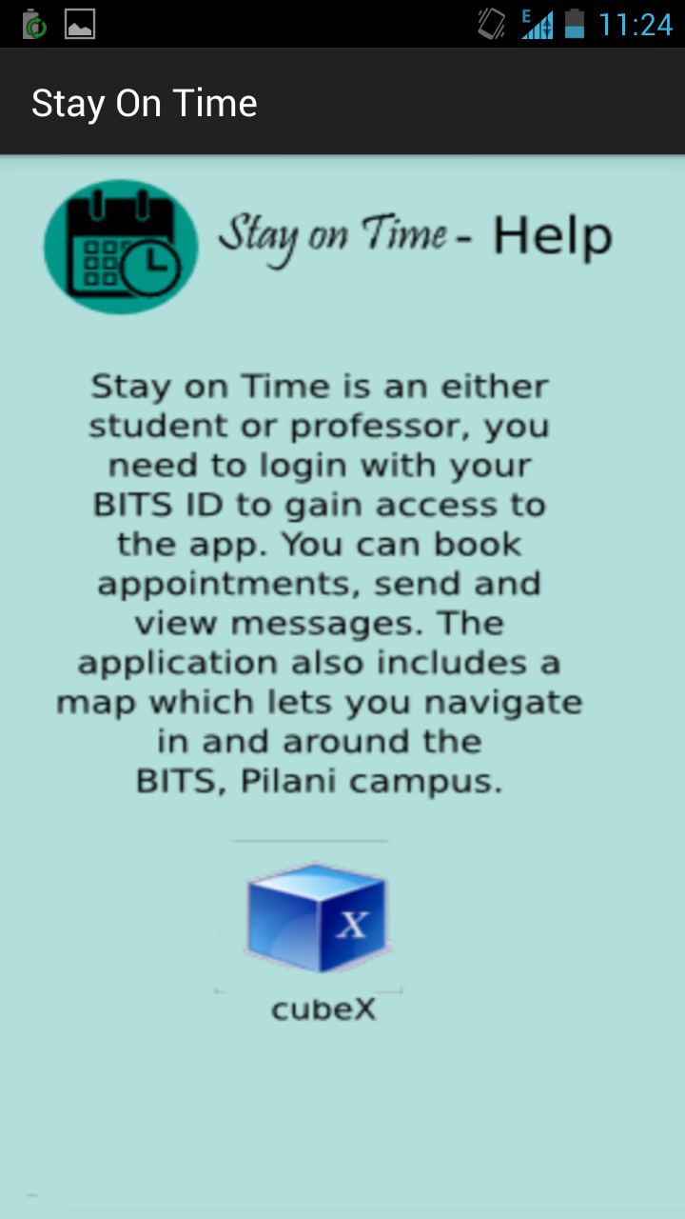
Stayon Time-help

Slide 19
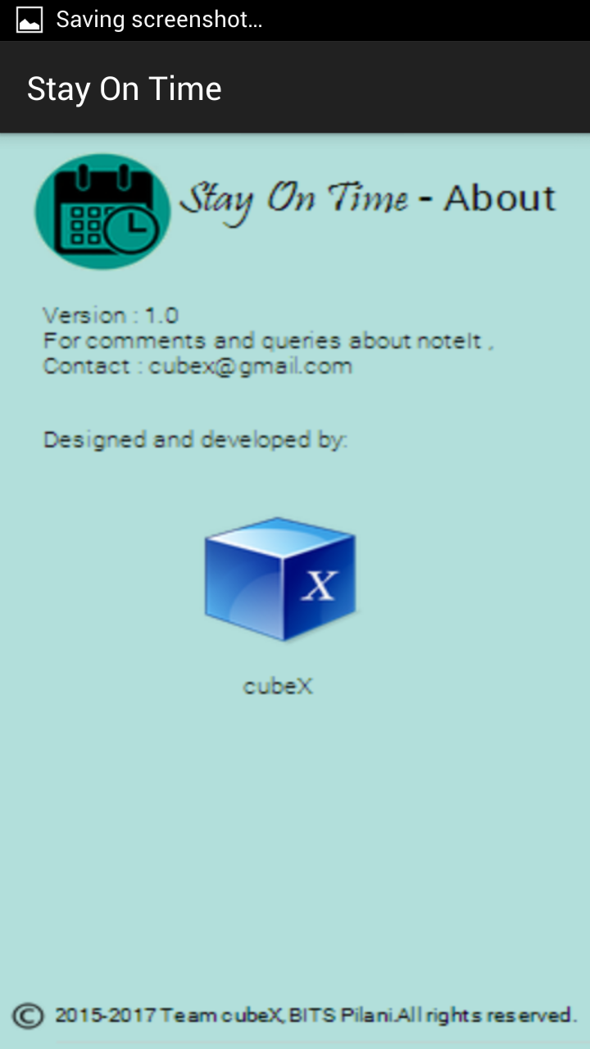
Stayon Time about

Slide 20
Future Work
Better backend interface for entering slots and details of faculty

Slide 21
Thank you
Any Queries …

